Slide 1
Search As A Metaphor For Learning
Litty Tressa George

Slide 2
Informed / Heuristic Search
Take the example of looking for a suitable Christmas gift.
Very few people would simply walk into each shop as they came across it, looking in each department in turn until they see a present that they desired .
Most people would go straight to the shop that they considered to be most likely to have a suitable gift.
If no gift was found in that shop, they would then proceed to the shop they considered to be the next most likely to have a suitable gift.
This kind of information is called a heuristic.

Slide 3
Heuristic Function
A heuristic evaluation function is a function that when applied to a node gives a value that represents a good estimate of the distance of that node from the goal (i.e. how far the goal is) .
For two nodes m and n, and a heuristic function f, if f(m) < f(n), then it should be the case that m is more likely to be on an optimal path to the goal node than n.
In other words, the lower the heuristic value of a node, the more likely it is an optimal path to a goal and the more sensible it is for a search method to examine that node.

Slide 4
A Good heuristic
For two heuristics h and j, heuristic h is said to be more informed than another heuristic, j, if h(node) ≤ j(node) for all nodes in the search space
In fact, in order for h to be more informed than j, there must be some node where h(node) < j(node). Otherwise they are as informed as each other.
A heuristic that reduces the number of nodes that need to be examined in the search tree is a good heuristic.

Slide 5
Heuristic Search
Search methods that use heuristics and are thus thought of as heuristic search methods, or heuristically informed search methods.
A search method or heuristic is informed if it uses additional information about nodes that have not yet been explored to decide which nodes to examine next.
The heuristic method, however, might not always give the best solution, but it guaranteed to find a good solution in reasonable time.
A search method is described as monotone if it always reaches a given node by the shortest possible path.
A monotonic heuristic is a heuristic that has this property.
An admissible heuristic is a heuristic that never overestimates the true distance of a node from the goal.

Slide 6
Informed Search Techniques
Best-First Search
A* Search
Bidirectional Search
Tabu Search
Beam Search
Simulated Annealing
Hill Climbing
Constraint Satisfaction Problems

Slide 7
Best-First Search
Best first search is a search algorithm in which a node is selected for expansion based on heuristic evaluation function f (n).
Heuristic function: f(n) = h(n) where, h(n) - estimated distance from node n to goal.
The node which is the lowest evaluation function is selected for the expansion because the evaluation measures distance to the goal.
Best first search algorithm is often referred greedy algorithm this is because it quickly attack the most desirable path as soon as its heuristic weight becomes the most desirable.

Slide 8
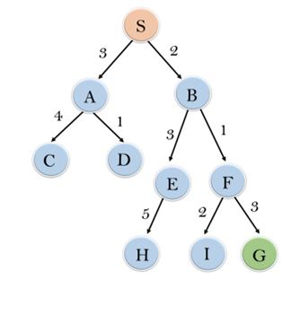
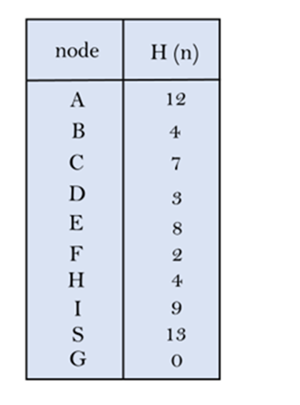
Example Problem

Slide 9
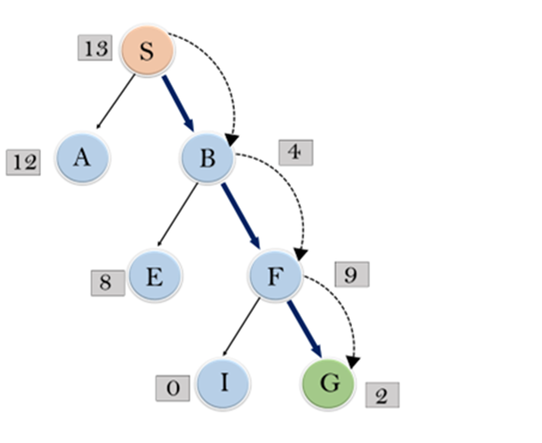

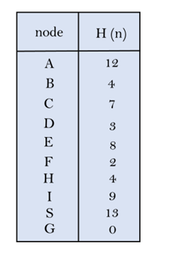
Solution
Consider the following example: At each iteration, each node is expanded using evaluation function f(n)=h(n) , which is given in the below table.

Slide 10
Search Procedure in short
Step 1: Place the starting node n into the OPEN list.
Step 2: In the OPEN list, identify node with the least Heuristic function.
Step 3: Expand that node and include its successors in the OPEN list & remove it from the OPEN list and place it in the CLOSED list.
Step 4: Check each successor of node n, and find whether any node is a goal node or not. If any successor node is goal node, then return success and terminate the search, else proceed to Step 5
Step 5 : For each successor node, algorithm checks for evaluation function f(n), and then check if the node has been in either OPEN or CLOSED list. If the node has not been in both list, then add it to the OPEN list..
Step 6: Continue search and whenever the OPEN list is empty, Stop and return failure.

Slide 11
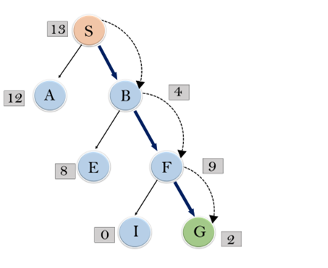
In this search example, we are using two lists which are OPEN and CLOSED Lists. Following are the iteration for traversing the above example.
Initial State→ Open [ S], Closed [ ]
Open [ ], Closed [ S ]
Iteration 1: Open [A, B], Closed [S]
Iteration 2: Open [A], Closed [S, B]
Iteration 3: Open [E, F, A], Closed [S, B]
: Open [E, A], Closed [S, B, F]
Iteration 4: Open [I, G, E, A], Closed [S, B, F]
: Open [I, E, A], Closed [S, B, F, G]
Hence the final solution path will be: S----> B----->F----> G

Slide 12
BFS Algorithm
The 1st step is to define the OPEN list with a single node, the starting node. Open[S]
The 2nd step is to check whether or not OPEN is empty. If it is empty, then the algorithm returns failure and exits.
The 3rd step is to remove the node with the best score, n, from OPEN and place it in CLOSED.
The 4th step “expands” the node n, where expansion is the identification of successor nodes of n.
The 5th step then checks each of the successor nodes to see whether or not one of them is the goal node. If any successor is the goal node, the algorithm returns success and the solution, which consists of a path traced backwards from the goal to the start node. Otherwise, proceeds to the sixth step.

Slide 13
In 6th step, for every successor node, the algorithm applies the evaluation function, f, to it, then checks to see if the node has been in either OPEN or CLOSED. If the node has not been in either, it gets added to OPEN.
Finally, the 7th step establishes a looping structure by sending the algorithm back to the 2nd step. This loop will only be broken if the algorithm returns success in step 5 or failure in step 2.

Slide 14
Advantages:
Best first search can switch between BFS and DFS by gaining the advantages of both the algorithms.
This algorithm is more efficient than BFS and DFS algorithms.
Disadvantages:
It can get stuck in a loop as DFS.
This algorithm is not optimal.

Slide 15
Algorithm Properties
Time Complexity & Space Complexity is of the O(b^{m}) , where, m is the maximum depth of the search space.
Completeness : Greedy best-first search is incomplete, even if the given state space is finite.
Optimality: Greedy best first search algorithm is not optimal.

Slide 16
A* Algorithm
A* algorithms are similar to best-first search but use a somewhat more complex heuristic to select a path through the tree.
The A* algorithm operates in the same manner as best-first search but uses the following function to evaluate nodes:
f(n) = g(n) + h(n) OR f(node) = g(node) + h(node)
g(node) is the cost of the path so far leading up to the node.
h(node) is an underestimate of the distance of the node from a goal state;
Function called as path-based evaluation function
When operating A*, the search proceeds through the path that have the lowest values of f.

Slide 17
A* is the name given to the algorithm where the h(node) function is admissible.
In other words, it is guaranteed to provide an underestimate of the true cost to the goal.
If a non admissible heuristic for h(node) is used, then the algorithm is called A.
A* is optimal and complete; [if the search tree is having finite branching factor & finite depth.]
In other words, it is guaranteed to find a solution, and that solution is guaranteed to be the best solution in a finite search scenario.
Both of these conditions are likely to be met in all real-world situations, and so for simplicity we can state that A* is complete; although, to be more accurate:

Slide 18

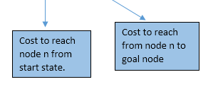
In A* search algorithm, we use search heuristic as well as the cost to reach the node. Hence we can combine both costs as following, and this sum is called as a fitness number.
It has combined features of UCS and greedy best-first search, by which it solve the problem efficiently.

Slide 19
Algorithm of A* search:
Step1: Place the starting node in the OPEN list.
Step 2: Check if the OPEN list is empty or not, if the list is empty then return failure and stops.
Step 3: Select the node from the OPEN list which has the smallest value of evaluation function (g+h), if node n is goal node then return success and stop, otherwise
Step 4: Expand node n and generate all of its successors, and put n into the closed list. For each successor n', check whether n' is already in the OPEN or CLOSED list, if not then compute evaluation function for n' and place into Open list.
Step 5: Else if node n' is already in OPEN and CLOSED, then it should be attached to the back pointer which reflects the lowest g(n') value.
Step 6: Return to Step 2.

Slide 20
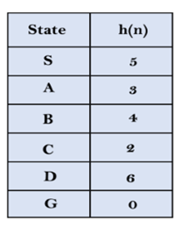
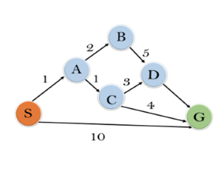
In this example, we will traverse the given graph using the A* algorithm.
The heuristic value of all states is given in the below table so we will calculate the f(n) of each state using the formula f(n)= g(n) + h(n), where g(n) is the cost to reach any node from start state.
Here we will use OPEN and CLOSED list.

Slide 21
Solution
Step 1
Considering Root Node S, S has two child nodes A & G . Also Evaluation Function is f(n) = g(n)+ h(n)
f(n) of A = g(n) upto A + h(n) of A ie 1 + 3 = 4
f(n) of G = g(n) upto G + h(n) of G ie 10 + 0 = 10
f(n) of A < f(n) of G, So the path to proceed from root node is S → A
Step 2
Current state is A . Node A has two child nodes B & C. So finding their f (n) value.
f(n) of B = g(n) upto B + h(n) of B ie 3 + 4 = 7
f(n) of C = g(n) upto C + h(n) of C ie 2 + 2 = 4
f(n) of C < f(n) of B, So the path to proceed from root node is S → A → C
Step 3
Current state is C. Node C has two child nodes D & G. So finding their f (n) value.
f(n) of D = g(n) upto D + h(n) of D ie 5+ 6 = 11
f(n) of G = g(n) upto G + h(n) of G ie 6+ 0 = 6
f(n) of G < f(n) of D, So the path to proceed from root node is S → A → C →G
Solution is S → A → C →G

Slide 22
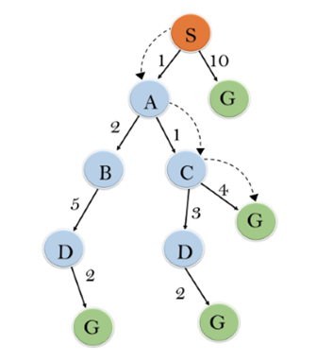
Solution
S--->A--->C--->G

Slide 23
Advantages:
A* search algorithm is the best algorithm than other search algorithms.
A* search algorithm is optimal and complete.
This algorithm can solve very complex problems.
Disadvantages:
It does not always produce the shortest path as it mostly based on heuristics and approximation.
A* search algorithm has some complexity issues.
The main drawback of A* is memory requirement as it keeps all generated nodes in the memory, so it is not practical for various large-scale problems.

Slide 24

Hill Climbing
“ If you try to climb a mountain in fog with an altimeter but no map, you might use the hill climbing Generate and Test approach ”

Slide 25

“ If you try to climb a mountain in fog with an altimeter but no map, you might use the hill climbing Generate and Test approach ”
Check the height one foot away from your current location in each direction: north, south, east, and west.
As soon as you find a position where the height is higher than your current position, move to that location and restart the process of search.
If all directions lead lower than your current position, then you stop and assume you have reached the summit.

Slide 26
Hill Climbing
Hill Climbing is heuristic search used for mathematical optimization problems in the field of
Artificial Intelligence
Hill climbing algorithm is a local search algorithm (immediate neighborhood) which continuously moves in the direction of increasing elevation/value of the function applied to find the peak of the mountain or best solution to the problem.
It terminates when it reaches a peak value where no neighbor has a higher value.
It is also called greedy local search as it only looks to its good immediate neighbor state and not beyond that.

Slide 27
Hill Climbing
A node of hill climbing algorithm has two components which are state and value.
Hill Climbing is mostly used when a good heuristic is available.
In this algorithm, we don't need to maintain and handle the search tree or graph as it only keeps a single current state.
Given a large set of inputs and a good heuristic function, it tries to find a sufficiently good solution to the problem.

Slide 28
Features of Hill Climbing
Following are some main features of Hill Climbing Algorithm:
Generate and Test variant
Hill Climbing is the variant of Generate and Test method. The Generate and Test method produce feedback which helps to decide which direction to move in the search space.
Greedy approach
Hill-climbing algorithm search moves in the direction which optimizes the function.
No backtracking
It does not backtrack the search space, as it does not remember the previous states.

Slide 29
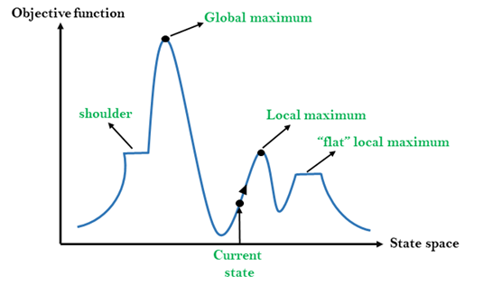
State-space Diagram for Hill Climbing:

Slide 30
Different regions in the state space landscape:
Local Maximum: Local maximum is a state which is better than its neighbor states, but there is also another state which is higher than it.
Global Maximum: Global maximum is the best possible state of state space landscape. It has the highest value of objective function.
Current state: It is a state in a landscape diagram where an agent is currently present.
Flat local maximum: It is a flat space in the landscape where all the neighbor states of current states have the same value.
Shoulder: It is a plateau region which has an uphill edge.

Slide 31
Algorithm for Simple Hill Climbing:
Step 1: Evaluate the initial state, if it is goal state then return success and Stop.
Step 2: Loop Until a solution is found or there is no new operator left to apply.
Step 3: Select and apply an operator to the current state.
Step 4: Check new state:
If it is goal state, then return success and quit.
Else if it is better than the current state then assign new state as a current state.
Else if not better than the current state, then return to step2.
Step 5: Exit.

Slide 32
Problems in Hill Climbing Algorithm:
1. Local Maximum/Foothill: Many search methods would reach the top of one of these foothills and, because there was nowhere higher nearby, would conclude that this was the best solution to the problem.
Solution: Backtracking technique can be a solution of the local maximum in state space landscape.ie backtrack the search space and explore other paths as well.

Slide 33
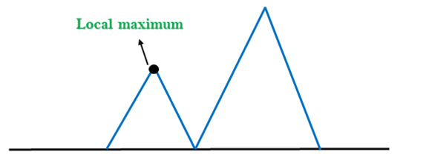

Slide 34
2. Plateau/ Flat Maximum: A plateau is the flat area of the search space in which all the neighbor states of the current state contains the same value, although there may be a well suitable maximum value somewhere nearby, there is no indication from the local terrain of which direction to go to find it.
A hill-climbing search might be lost in the plateau area.
Solution: The solution for the plateau is to take big steps or very little steps while searching, to solve the problem. Randomly select a state which is far away from the current state so it is possible that the algorithm could find non-plateau region.

Slide 35
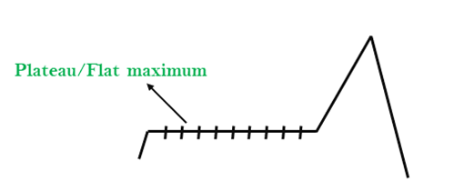

Slide 36
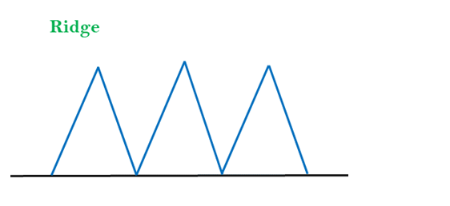
3. Ridges: A ridge is a special form of the local maximum. It has an area which is higher than its surrounding areas, but itself has a slope, and cannot be reached in a single move.
Solution: With the use of bidirectional search, or by moving in different directions, we can improve this problem.

Slide 37
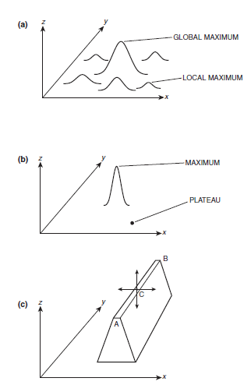


Slide 38
Constraint Satisfaction Problems

Slide 39
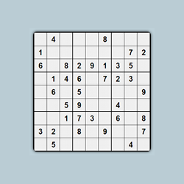

Constraint Satisfaction Problems

Slide 40

Constraint Satisfaction Problems
Consider a Sudoku game with some numbers filled initially in some squares. You are expected to fill the empty squares with numbers ranging from 1 to 9 in such a way that no row, column or a block has a number repeating itself.
This is a very basic Constraint Satisfaction Problem.

Slide 41
You are supposed to solve a problem keeping in mind some constraints.
The remaining squares that are to be filled are known as variables and the range of numbers (1-9) that can fill them is known as a domain.
Variables take on values from the domain.
The conditions governing how a variable will choose its domain are known as constraints.

Slide 42
Definition- CSP
A constraint satisfaction problem (CSP) is a problem that requires its solution within some limitations/conditions also known as constraints.
It consists of the following:
A finite set of variables which stores the solution. (V = {V1, V2, V3,....., Vn} )
A set of discrete values known as domain from which the solution is picked. (D = {D1, D2, D3,.....,Dn} )
A finite set of constraints. (C = {C1, C2, C3,......, Cn} )
Rule : A consistent assignment does not violate the constraints.

Slide 43
CSP – Problem Definition
We are given a set of variables, a finite and discrete domain for each variable, and a set of constraints.
Each constraint is defined over some subset of the original set of variables, and limits the combinations of values that the variables in this subset can take.
The goal is to find one assignment to the variables such that the assignment satisfiesall the constraints.

Slide 44
CSP- Points to be considered..
The elements in the domain can be both continuous and discrete but in AI, we generally only deal with discrete values.
Also, note that all these sets should be finite except for the domain set.
Each variable in the variable set can have different domains.
For example, consider the Sudoku problem again. Suppose that a row, column and block already have 3,5 and 7 filled in. Then the domain for all the variables in that row, column and block will be {1,2,4,6,8,9}.

Slide 45
CSP Problem Examples
The following problems are some of the popular problems that can be solved using CSP:
CryptArithmetic (Coding alphabets to numbers.)
N-Queens (In an n-queen problem, n queens should be placed in a n X n matrix such that no queen shares the same row, column or diagonal.)
Map Coloring (Coloring different regions of map ensuring no adjacent regions have the same color.)
Crossword Puzzles.
Sudoku (A number grid.)
Latin Square Problem

Slide 46
Example: Map-coloring

Slide 47

Variables: WA, NT, Q, NSW, V, SA, T
Domains: Di= {red,green,blue}
Constraints: adjacent regions must have different colors
•e.g., WA ≠NT
—So (WA,NT) must be in {(red,green),(red,blue),(green,red), …}

Slide 48
Solution
Solutions are complete and consistent assignments,
•e.g., WA = red, NT = green, Q = red, NSW = green, V = red, SA = blue, T = green

Slide 49
A binary CSP can be depicted by a constraint graph, in which each node represents a variable, and each arc represents a constraint between variables represented by the end points of the arc.

Slide 50
CSP Representations
Constraint graph:
nodes are variables
arcs are constraints
Standard representation pattern:
variables with values
Constraint graph simplifies search.
e.g. Tasmania is an independent sub problem

Slide 51
Constraints
Unary constraints involve a single variable,
Binary constraints involve two variables,
Map Coloring problem: A binary CSP because each constraint relates two variables
Higher-order constraints involve 3 or more variables
Preference (soft constraints) e.g. red is better than green can be represented by a cost for each variable assignment

Slide 52
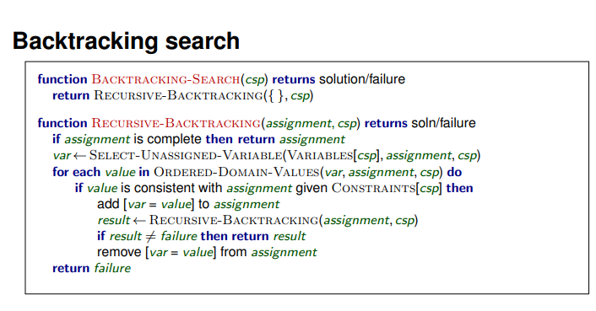
Backtracking Algorithm for CSP
c

Slide 53
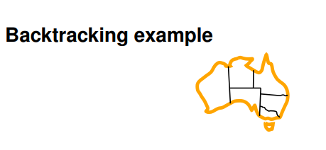
c

Slide 54
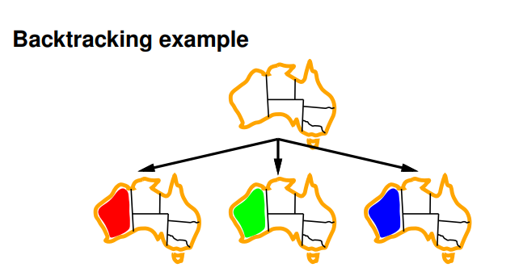
c

Slide 55
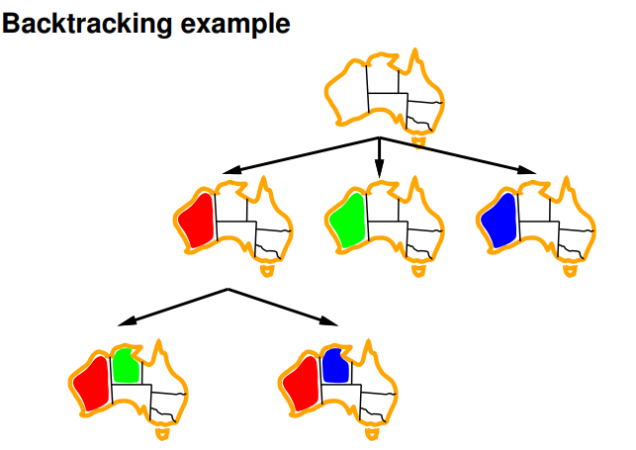

Slide 56
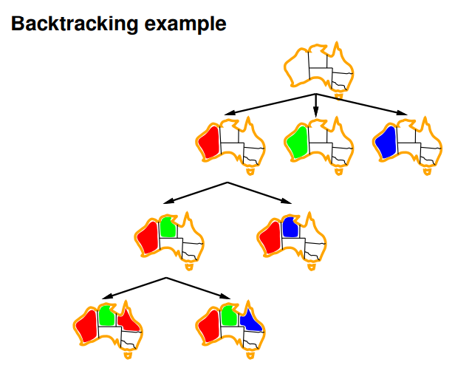
c

